Slide 1
Comments CSF-PR
Jan/Feb 2020
Astrid

Slide 2
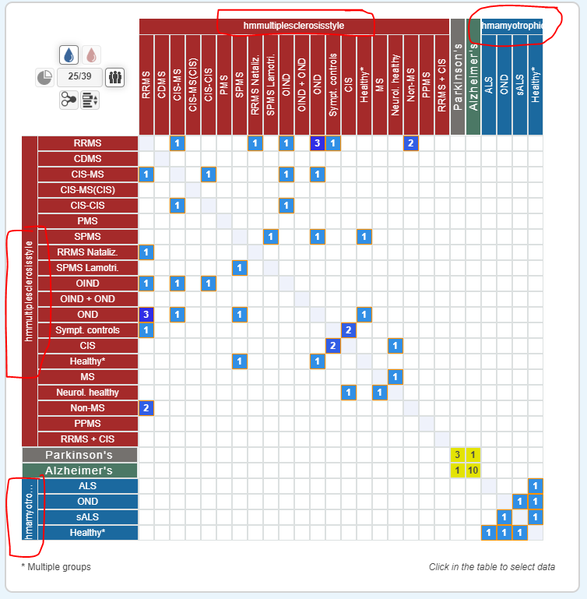
Heading naming issues (Search Amyloid → load all→ Heat map

Slide 3
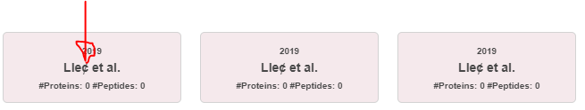
What is this letter? Should be Lleó

Slide 4
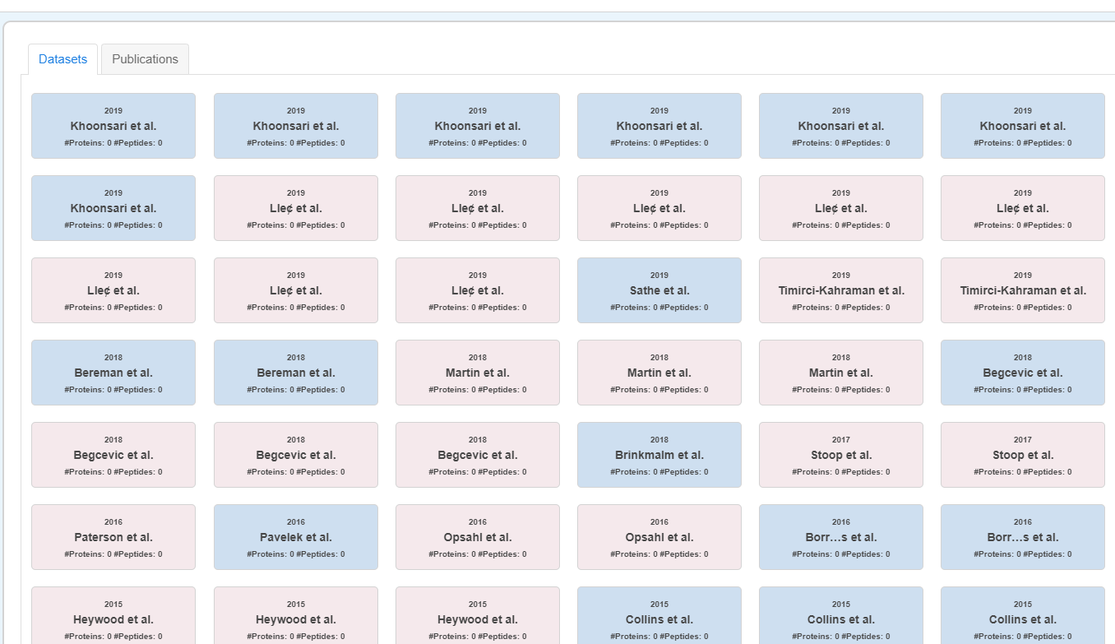
Include PMID in here to make it clearer what the colouring means

Slide 5
Sorting/Order of disease groups in heat map
See file: Disease Regrouping sheet → Sheet: Sorting in heat map

Slide 6
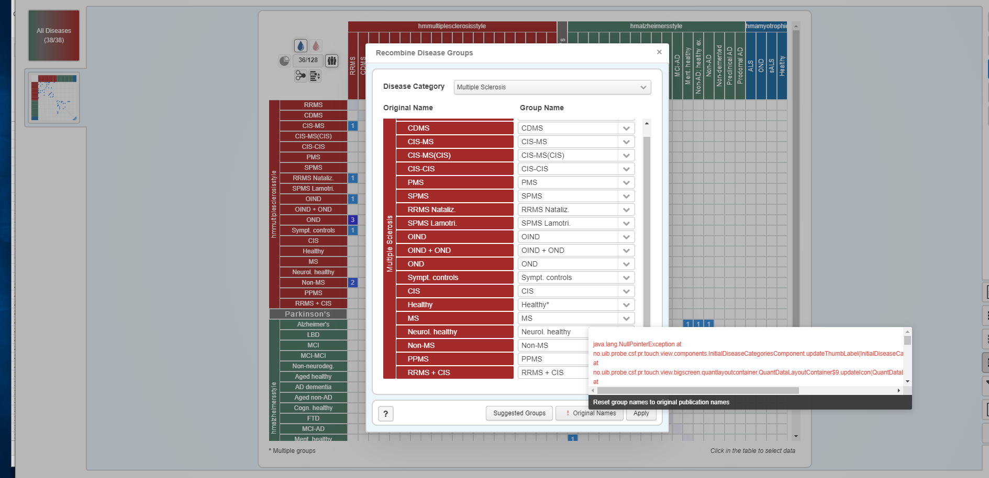
After serach →Recombine → MS selected → Original names

Slide 7
Protein details tab
After sorting by trend, info on #patients diappear (all symbols are the same size). Cant go back

Slide 8
Shows only ALS after applying filter (PRM)
Back to start after testing div things. Start → All is shown in heat map → filter applied and then only ALS results are displayed (others are collapsed, lots of results there). Did not have any ALS filters on in previous steps..
Tried to reproduce error, refreshed page and started again. This time all was shown except Parkinson (was collapsed although there were results there)

Slide 9
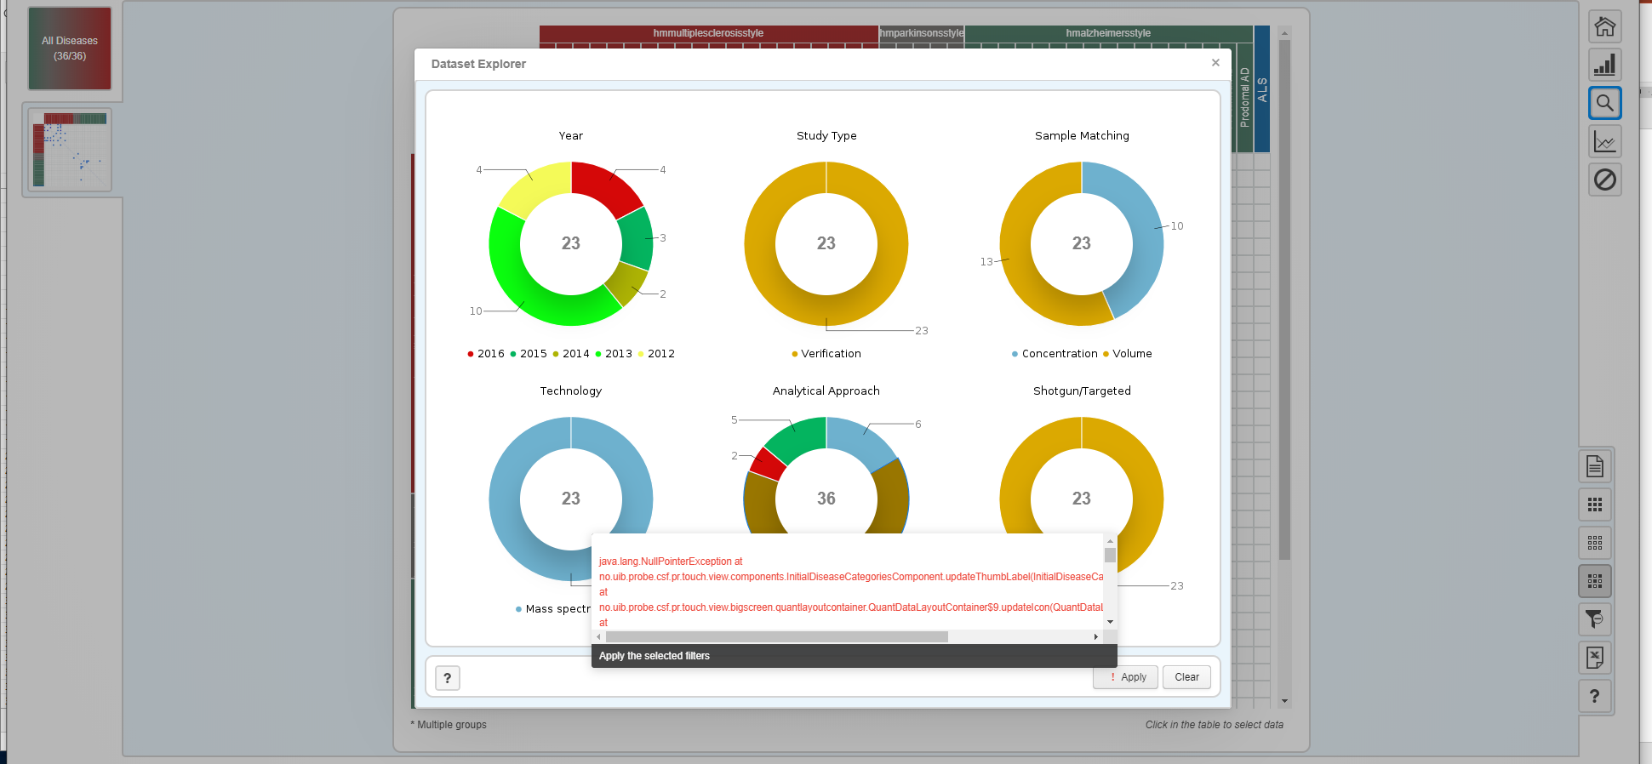
Exception after applying filters after searching for 1 protein and loading all results. Tried to apply SRM filter on the heat map

Slide 10
Filters
After applying filters only 1 paper was in heat map (in MS). After clicking the ? under other diseases to open and see filters were reset. Should just be able to open and see that there is no data there. Opening a disease caategory should not reset filter.
Also, should instead of ? Have 0 if there is no data there after applying the filter. Then one would probably not click it ☺

Slide 11
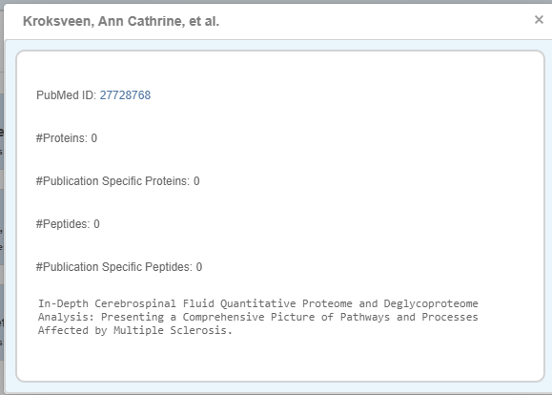
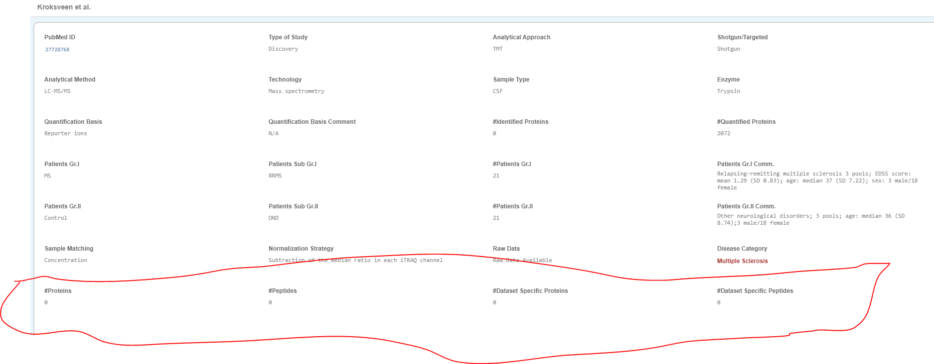
Publication/Dataset specific proteins peptides etc seems to always be 0??

